Slide 1

Stock-Ticker
Sprint II
Team WasserFall
Washington College
Spring 2018

Slide 2

Overview of the Sprint
Improving the UI ( Search Feature)
Creating a Landing Page
Connecting APIs and Data to the Display Graph

Slide 3
Accomplishments
The old UI is intact, but now it looks more neat and the drop down menu is empty.
The graph has a new crisp background and displays stock data in different time interval categories.
Now the time interval JButtons do provide different options for displaying historical data.
JLabels were used for testing purposes with any missing panels.

Slide 4
Landing Page
Four Different Panels with Grid Layout
Two JPanels ( Log In, and Change Password)
Two JButtons (Change Password, Cancel)
Change Password Panel

Slide 5
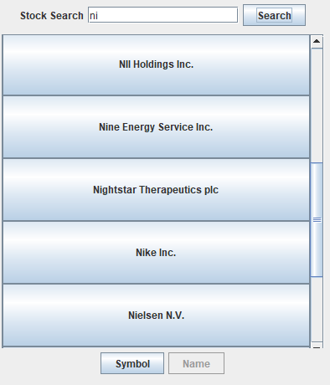
Search Function
Call IEX API and copy the reference data
It search for any stocks that start with the letter that in the Jtextfield
Can Search by stock name or stock symbol
Code need to be optimized

Slide 6
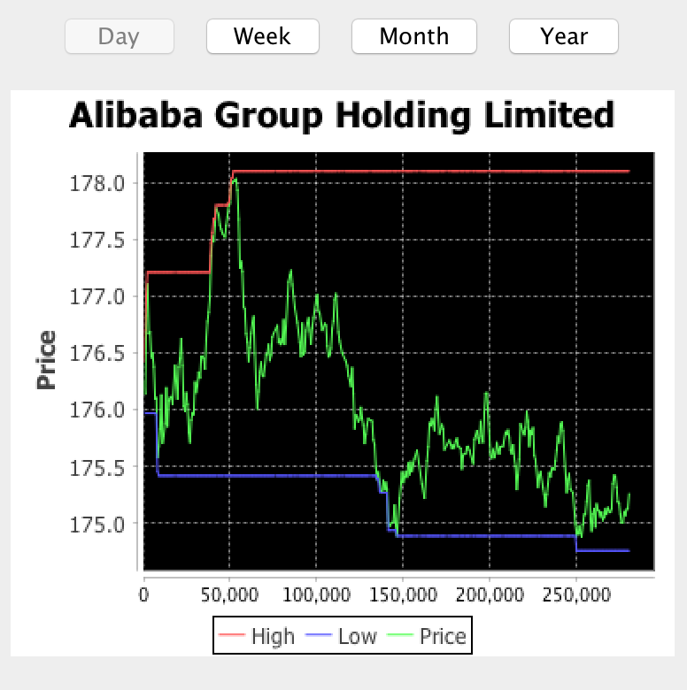
Display Graph
Imports and Implements the jFreeChart library.
Able to take data and display them dynamically.
Extremely effective to display real-time and especially historical stock prices.
Fully integrated into the main UI within a JPanel.

Slide 7
Full Demo

Slide 8

Next Sprint
New Simulation Frame for Trading stocks and Displaying User’s Complete Portfolio.
Further Polishing of the UI.
Full Integration of the Landing Page.

Slide 9
Question

